Slide 1
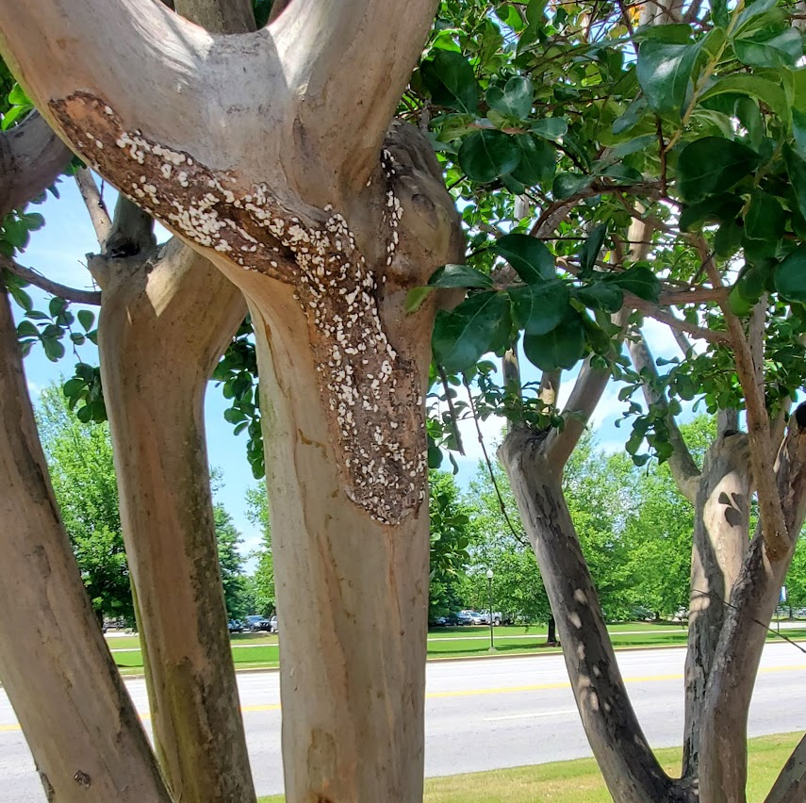
Limonene for the Management of Crape Myrtle Bark Scale
Jordan Melson, David Held
Department of Entomology and Plant Pathology
Auburn University

Slide 2
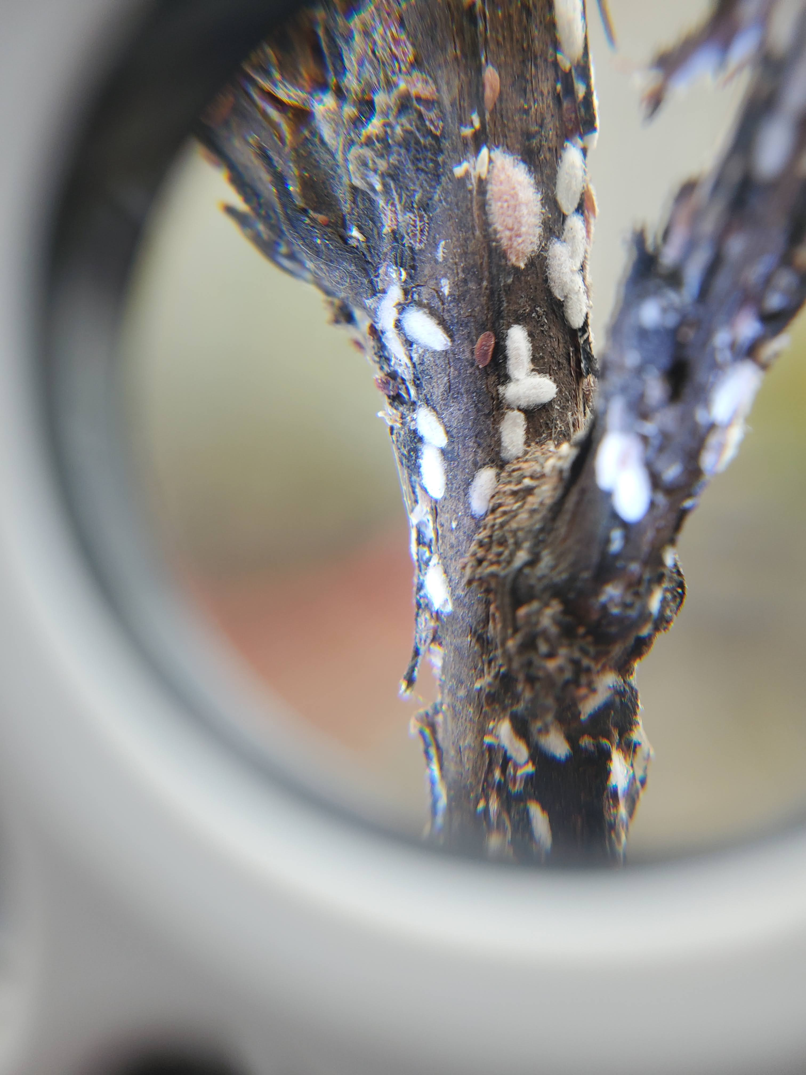
Female Adult
Male Adult
Crawler

Slide 3
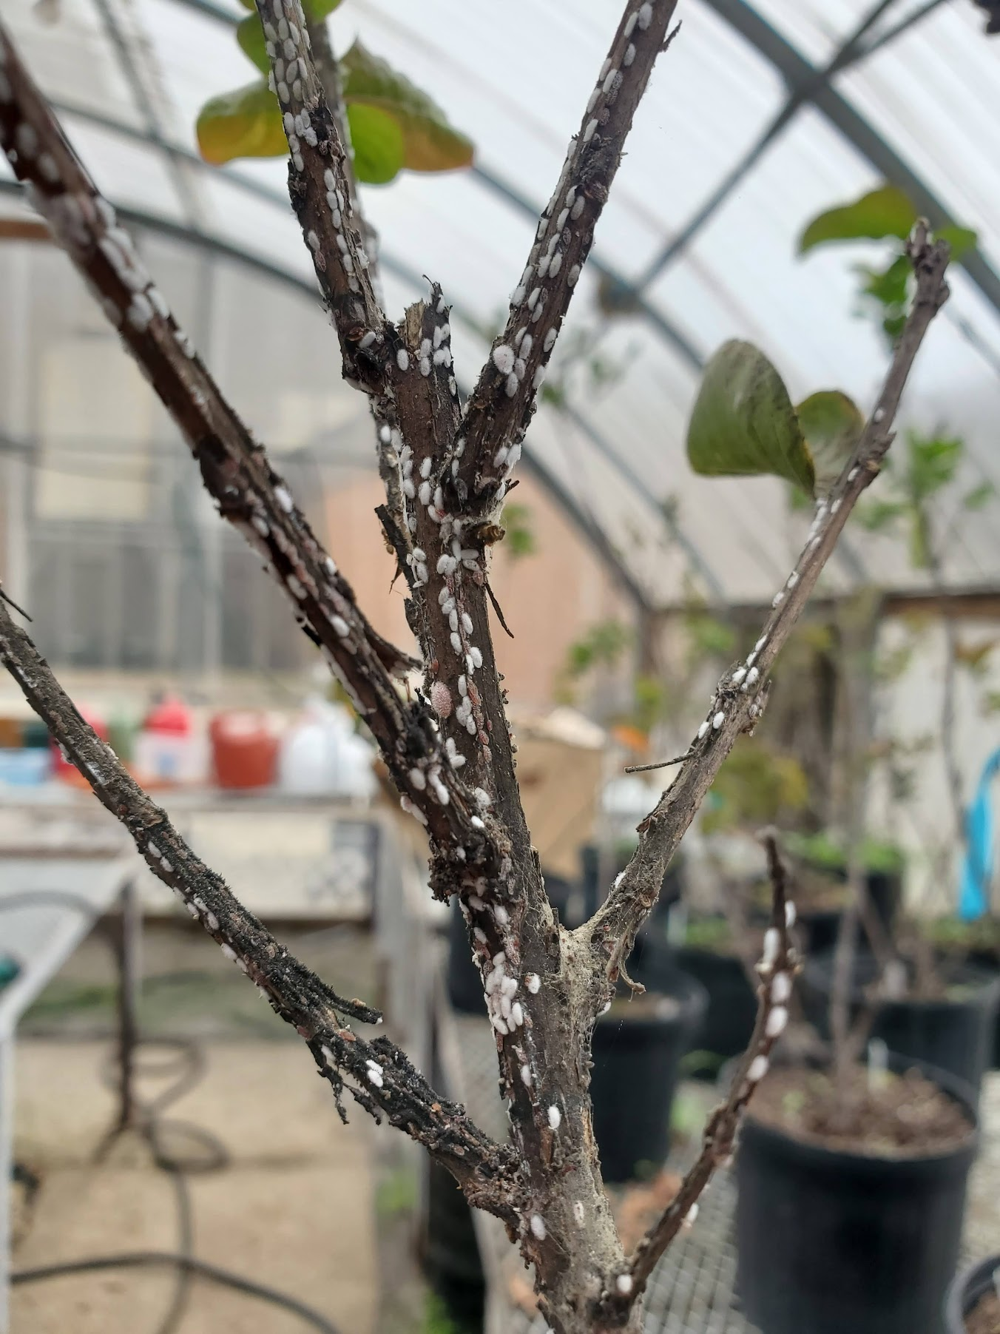
Crape Myrtle Bark Scale
Reduces the aesthetic value
Can be found anywhere crape myrtles are grown
Currently treated with Neonicotinoids
Systemic transfer into pollen and nectar (Krischick et al., 2015)
Can harm pollinators and other beneficial insects like natural enemies

Slide 4
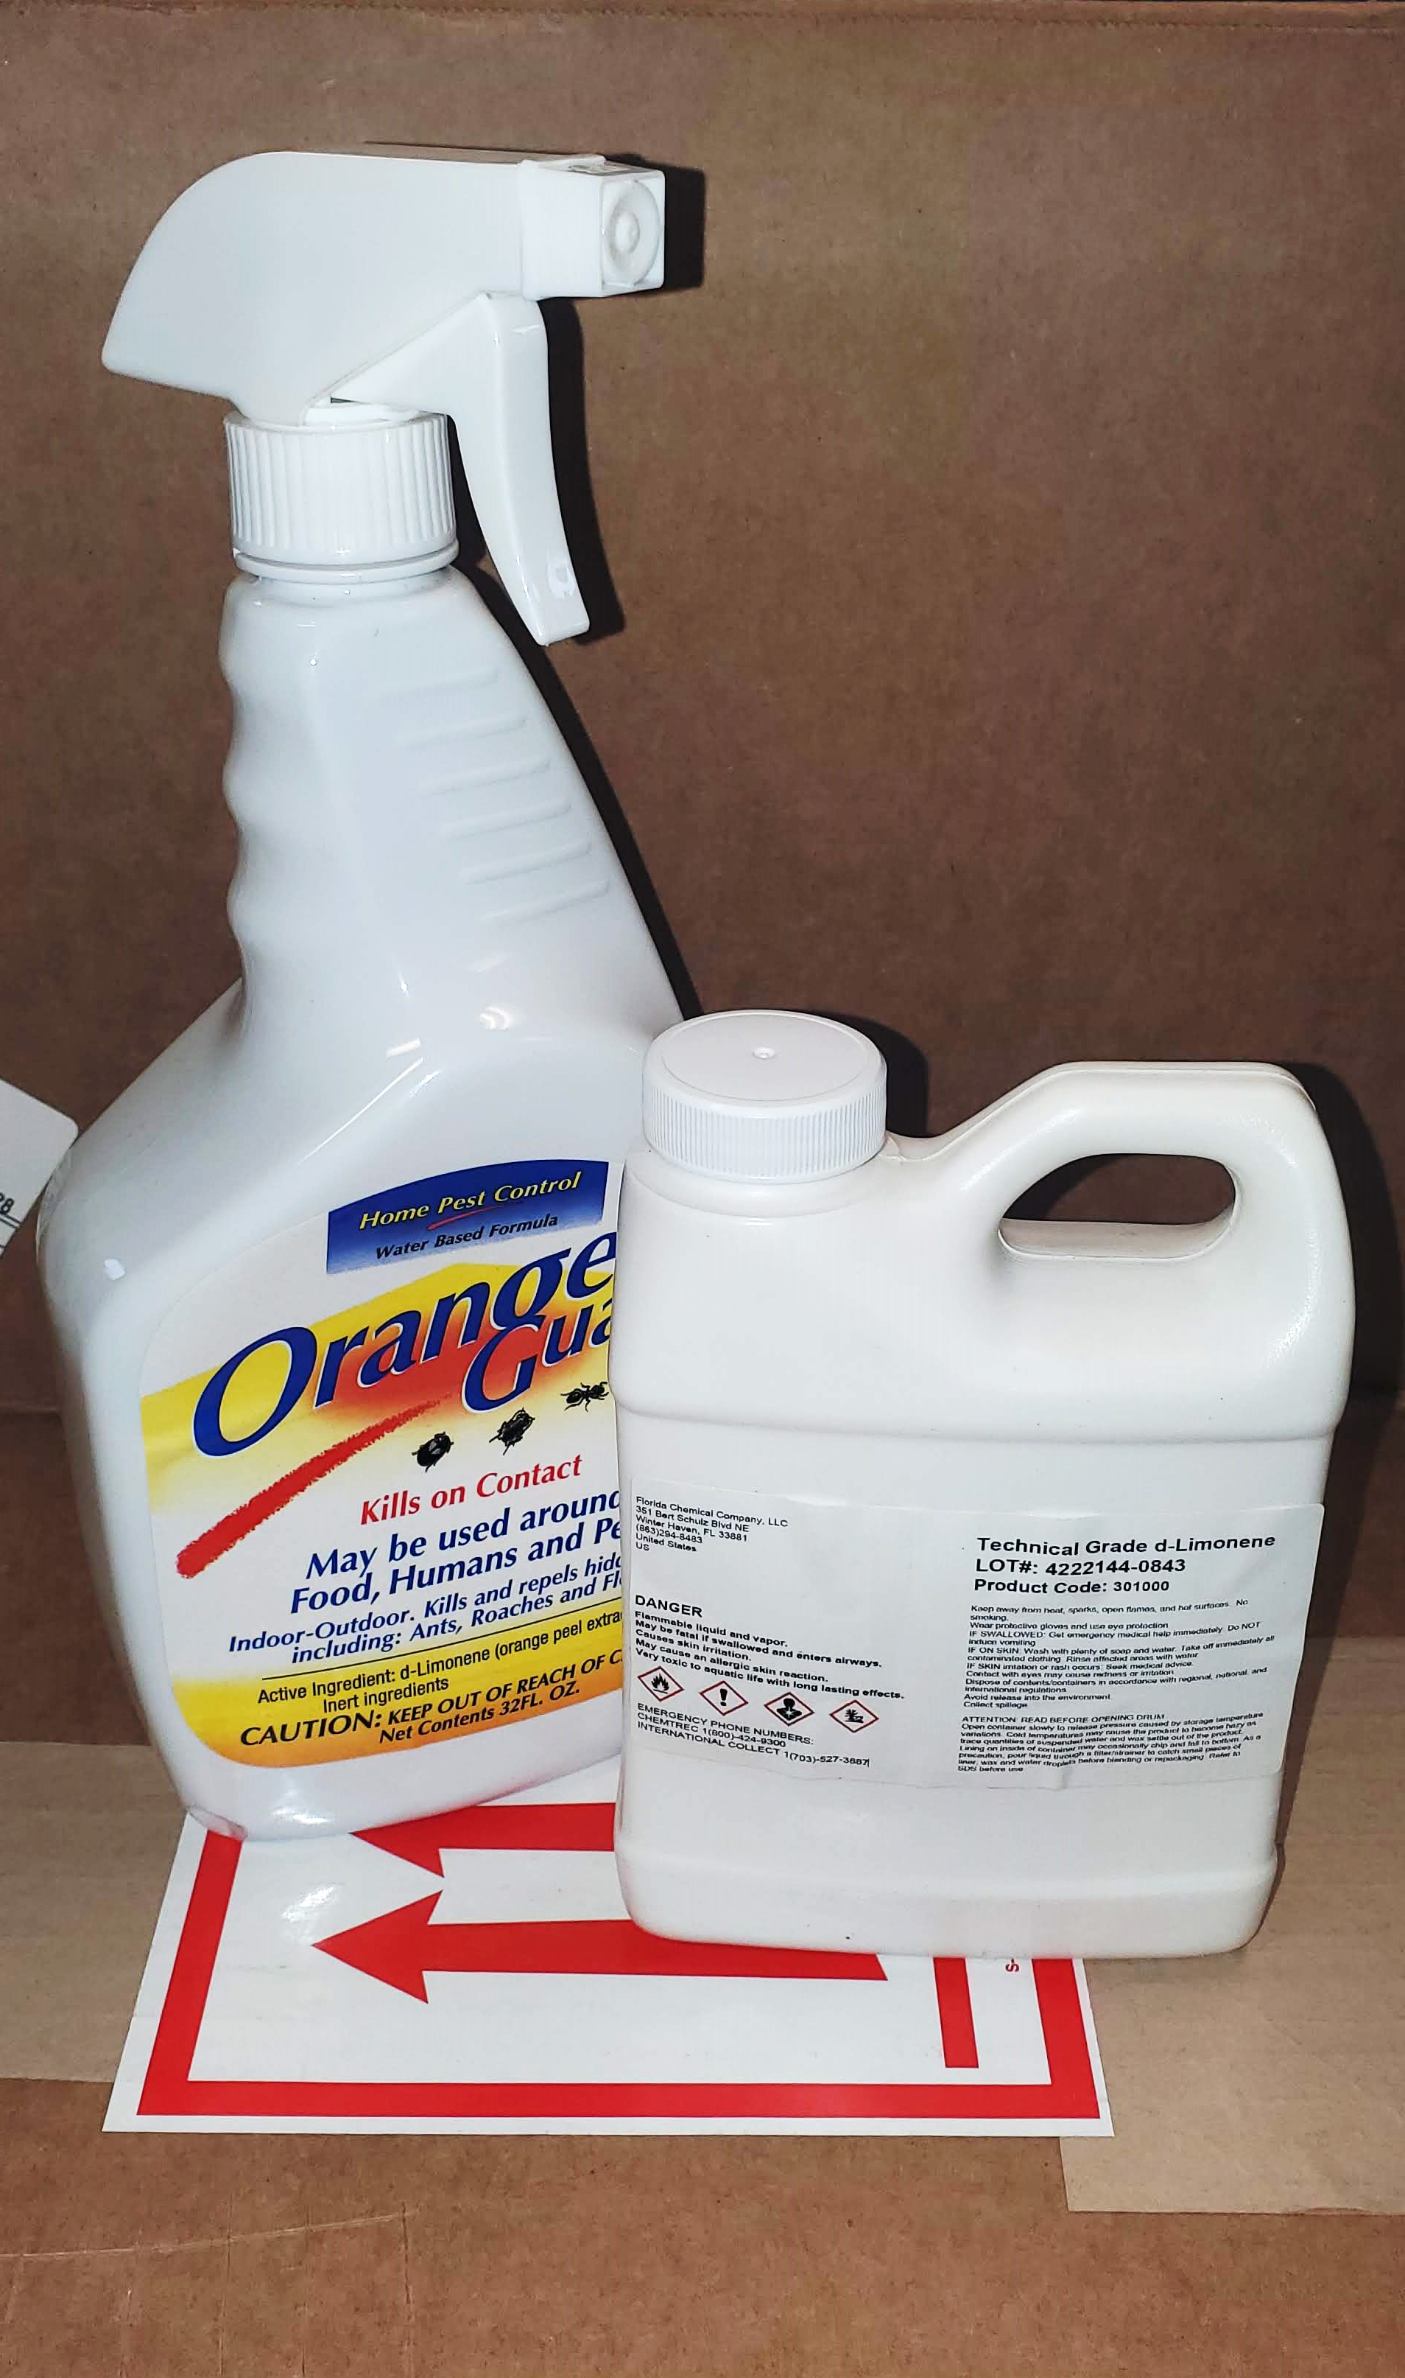

Limonene
Herbivore Induced-Plant Volatile (HIPV)
A citrus extract studied for its deterrent and insecticidal properties
69%-100% effectiveness for control of mealybugs and green scale (Hollingsworth et al.,2005)

Slide 5
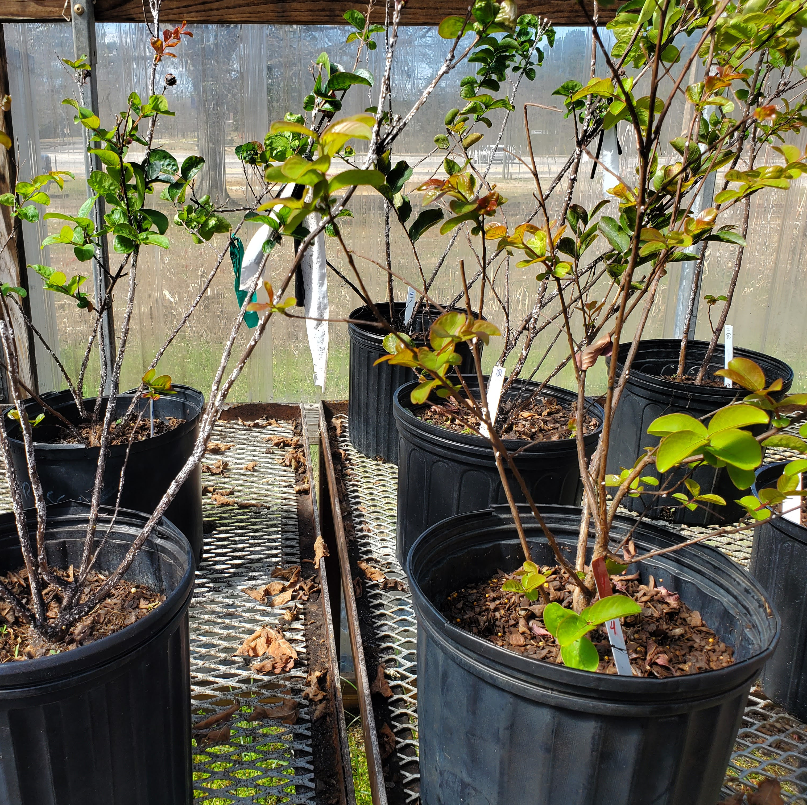
Methods
36 3 gal CMBS Infested Crape Myrtles
6 Treatments
Non-treated
Water Treated
Dinotefuran
Pyriproxifen
Imidacloprid
Limonene
8 weeks: Treatments and Population Counts

Slide 6
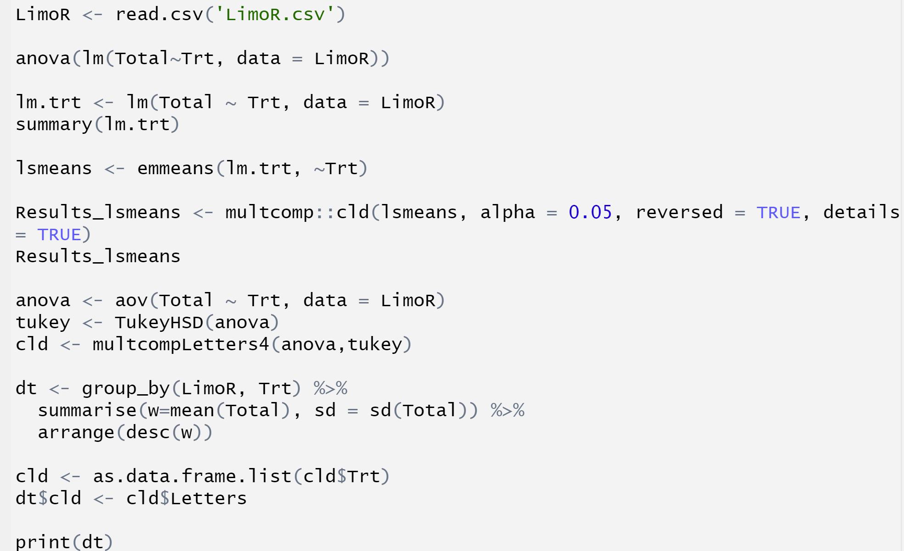
Statistics Code

Slide 7
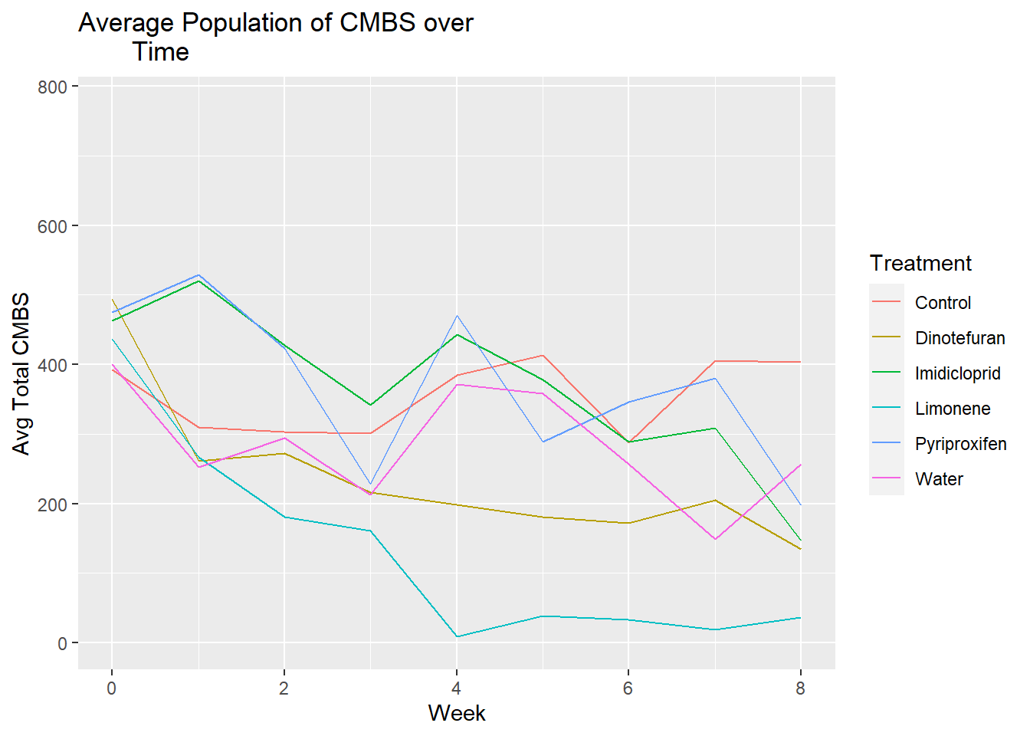
Results
ggplot(LimoR, aes(x = Date, y = Total, group = Trt, color = Trt)) + stat_summary(geom ="line")+ labs(x = "Week", y = "Avg Total CMBS", title = "Average Population of CMBS over Time")+ LC

Slide 8
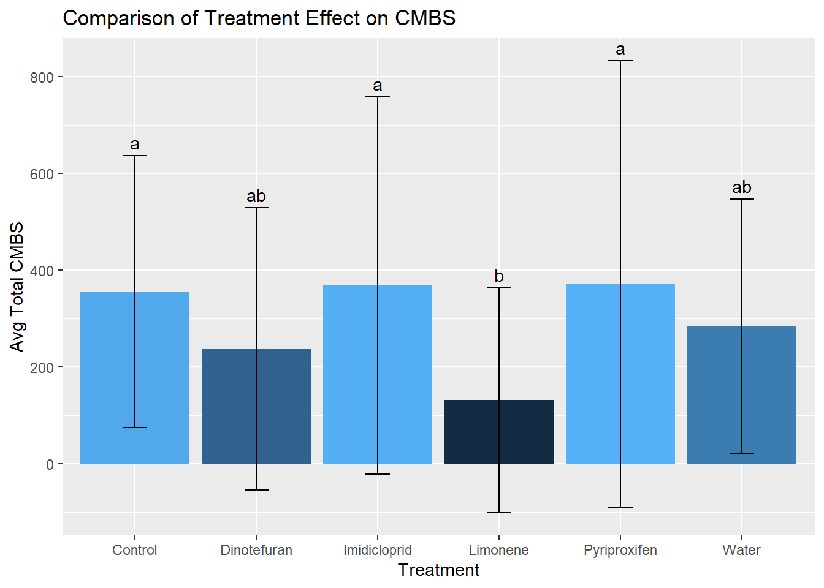
Results
Treatment did have a significant effect on the total number of CMBS on the crape myrtles (p=0.0006).
Limonene had significantly less CMBS than control (p=0.006) and imidacloprid (p=0.003).
Limonene was not significantly different from dinotefuran or water but is the only of those treatments that was significantly different from the others.
geom_text(aes(label = cld, y = w + sd), vjust = -0.5)

Slide 9
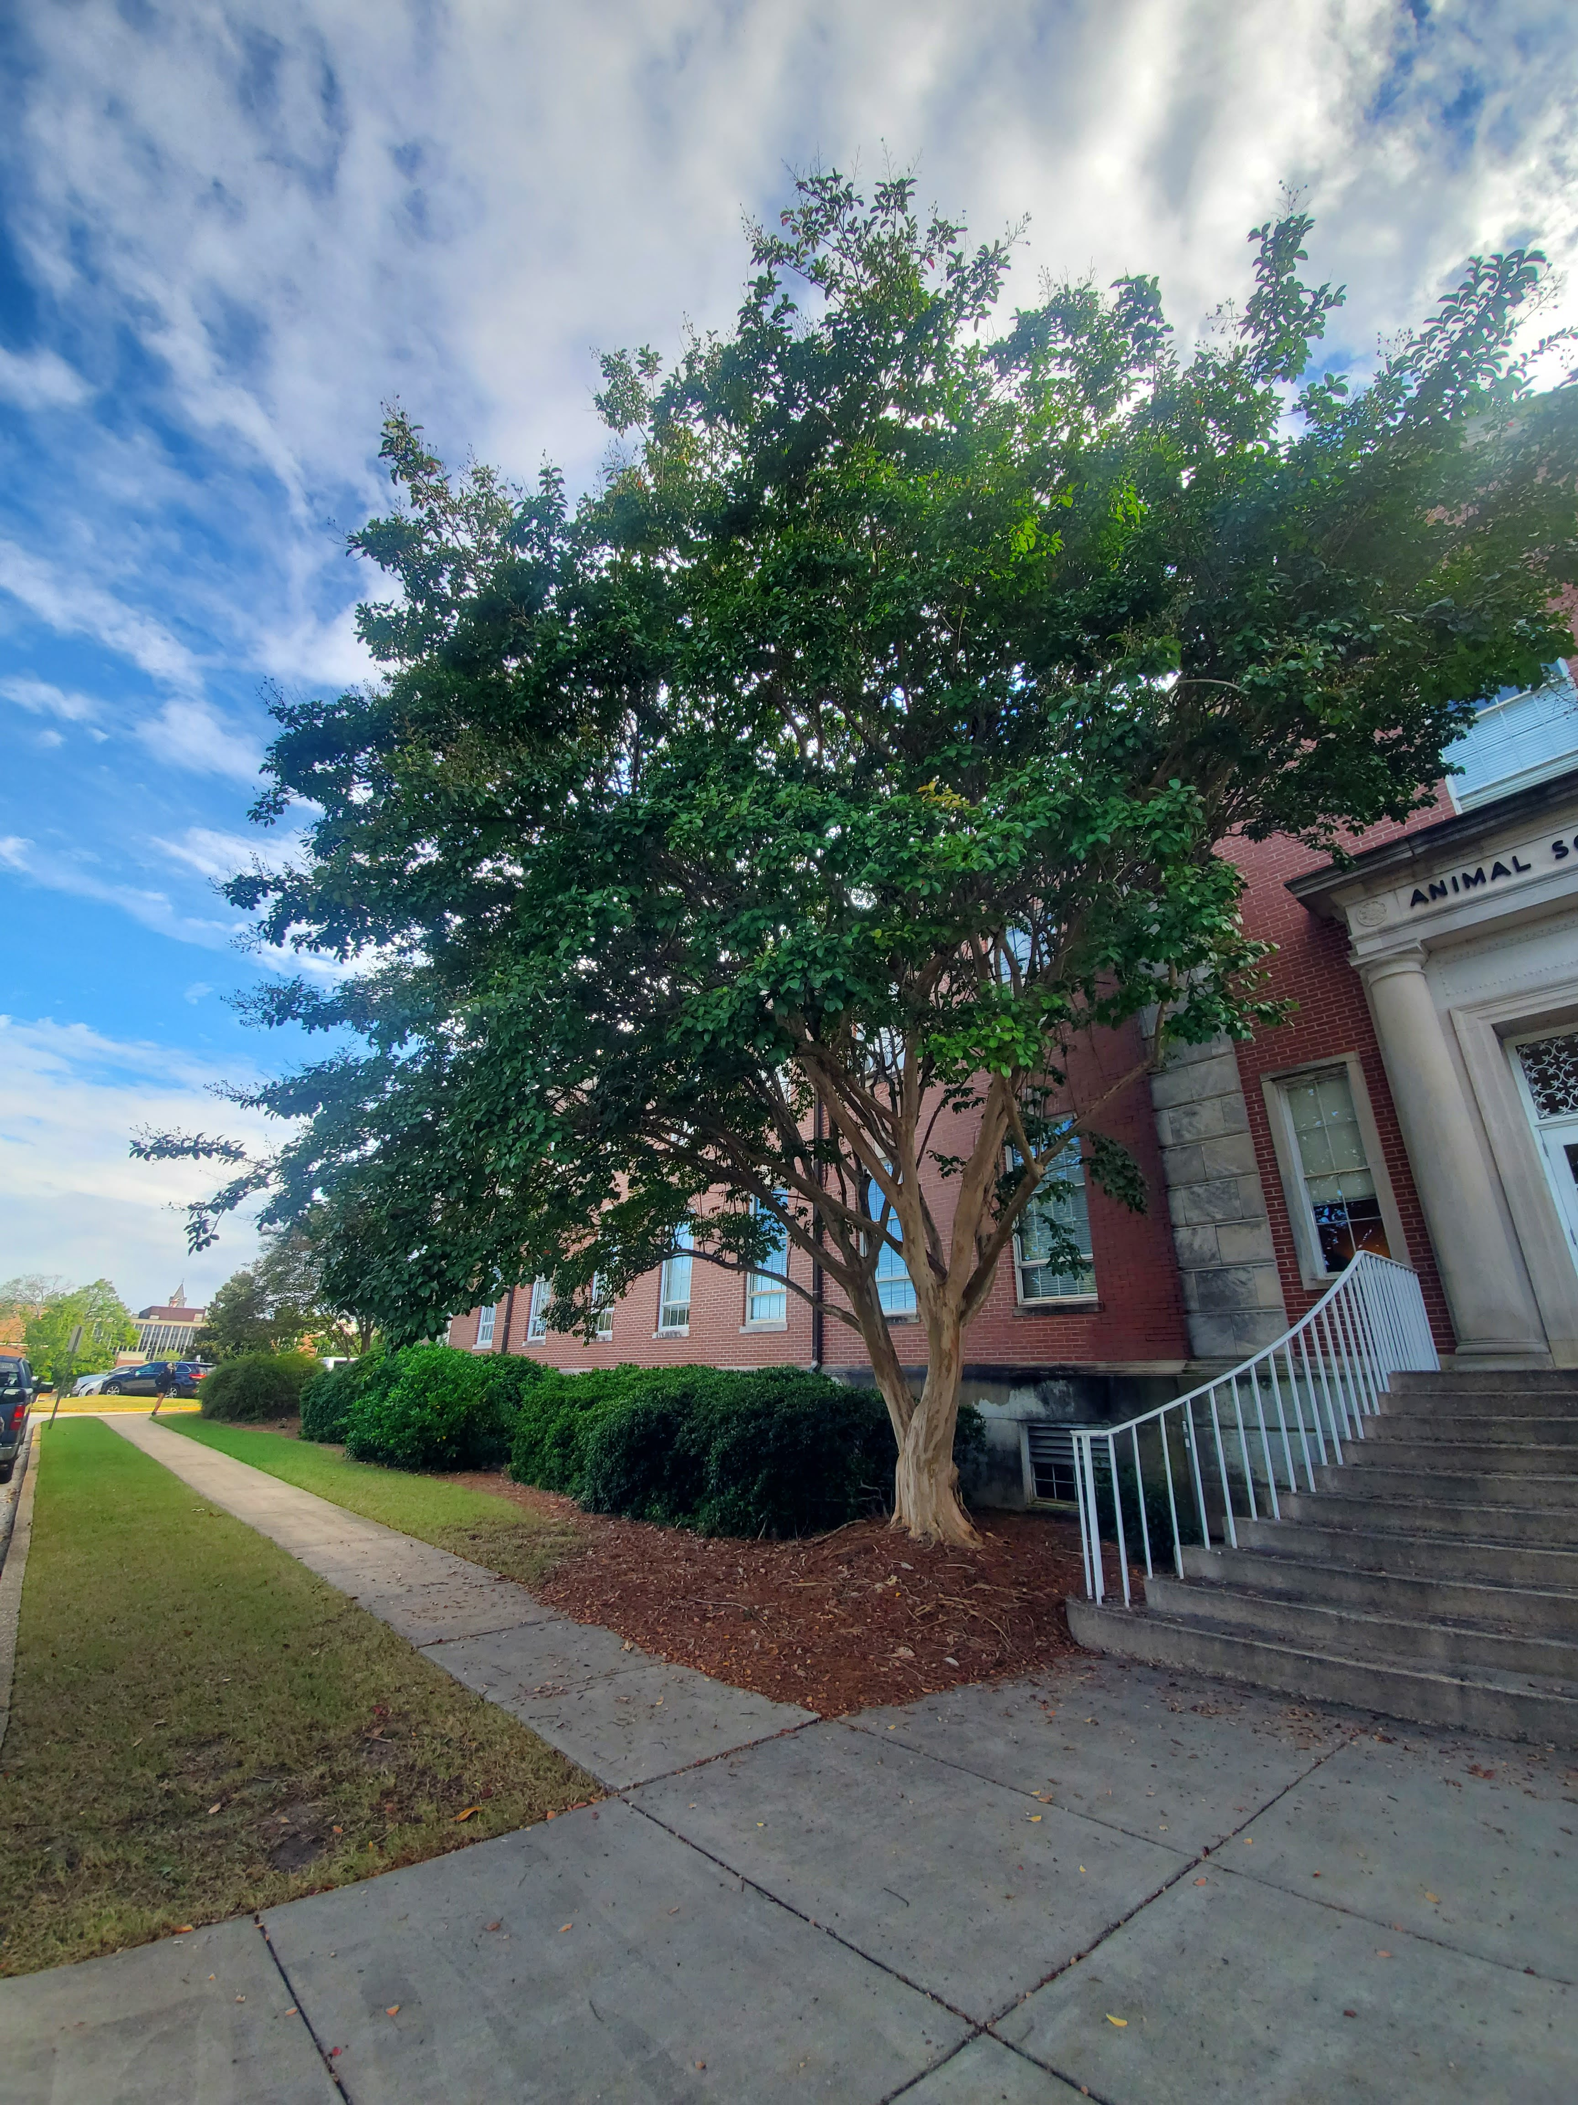
Conclusions
Limonene, a biorational, is providing control above the levels of imidacloprid when used weekly.
We are looking further into the use of limonene for the control of CMBS, possible treatment regimes, and natural enemy recruitment.

Slide 10
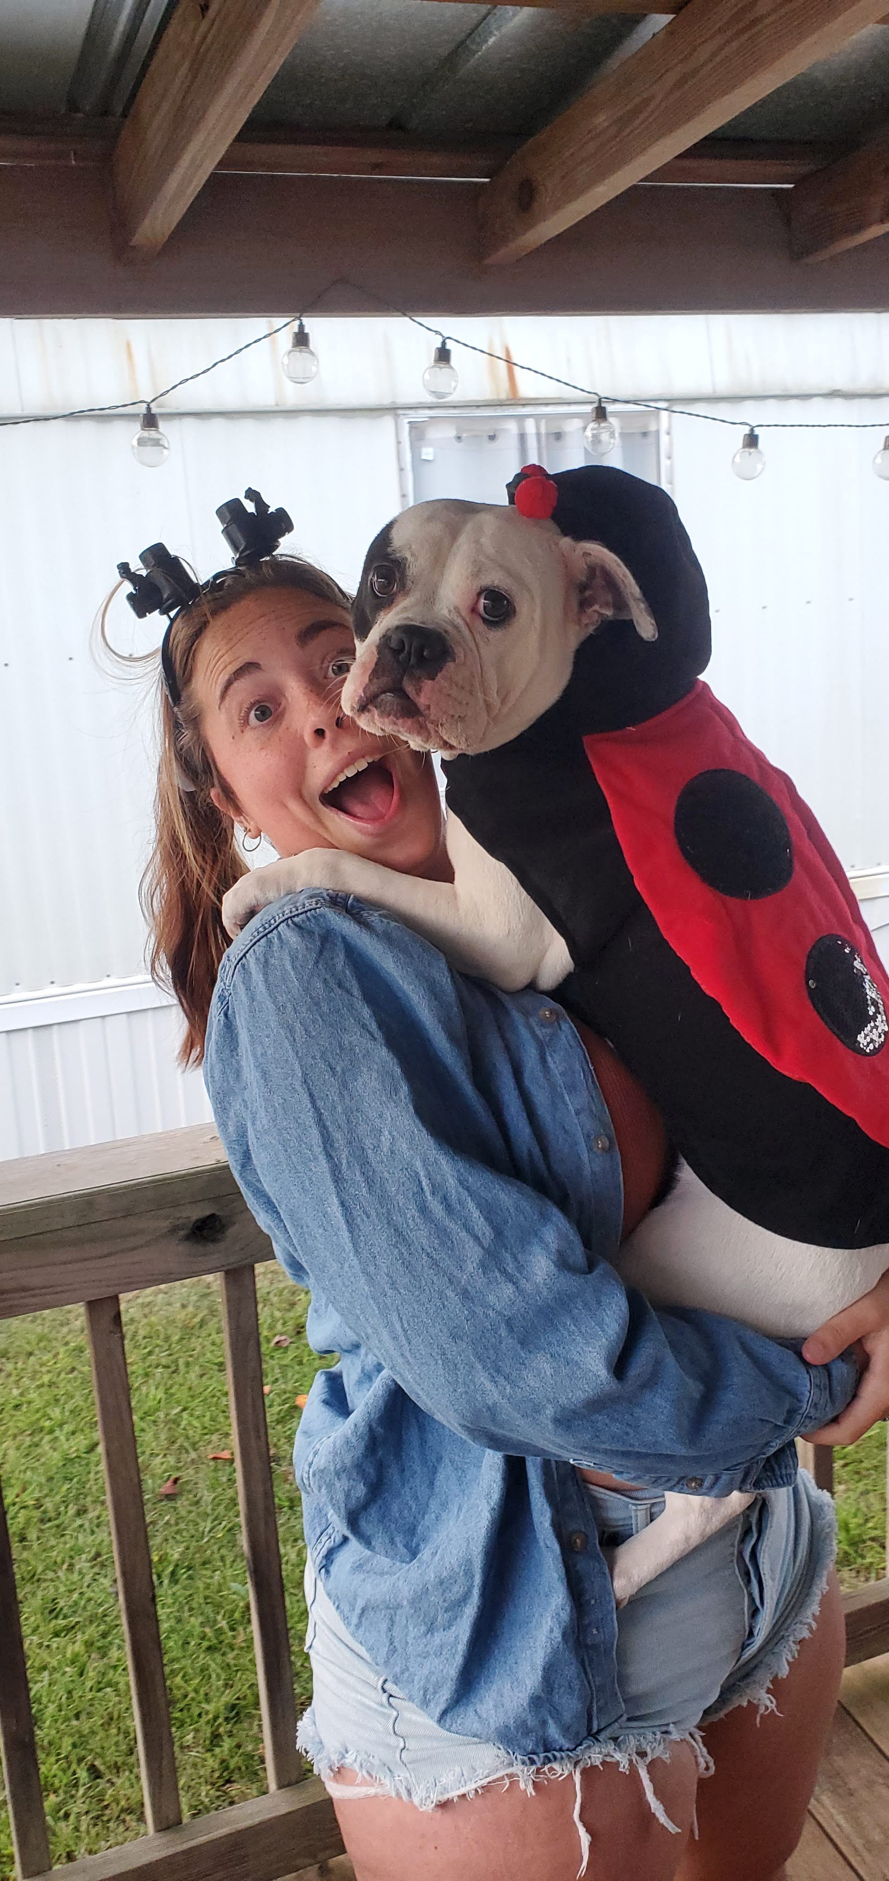
QUESTIONS?
GitHub Link:
https://github.com/jmm0206

Slide 11
Resources
Alhmedi, A., Haubruge, E., & Francis, F. (2010). Identification of limonene as a potential kairomone of the harlequin ladybird Harmonia axyridis (Coleoptera: Coccinellidae). Eur. J. Entomol., 107(4), 541-548. doi: 10.14411/eje.2010.062
Chappell, M., Braman, S., Williams-Woodward, J., & Knox, G. (2012). Optimizing Plant Health and Pest Management of Lagerstroemia spp. in Commercial Production and Landscape Situations in the Southeastern United States: A Review. Journal of environmental horticulture, 30, 161-172.
Gilder, K., Gu, M., Merchant, M., & Heinz, K. (2021). Inventory and Food Web of Arthropod Fauna Associated with Lagerstroemia spp.1 in Texas. Southwestern Entomologist, 46(2), 413-438. doi: 10.3958/059.046.0212
Hollingsworth, R. (2005). Limonene, a Citrus Extract, for Control of Mealybugs and Scale Insects. Journal Of Economic Entomology, 98(3), 772-779. doi: 10.1603/0022-0493-98.3.772
Ibrahim, M., Kainulainen, P., & Aflatuni, A. (2001). Insecticidal, repellent, antimicrobial activity and phytotoxicity of essential oils: With special reference to limonene and its suitability for control of insect pests. Agricultural and Food Science, 10(3), 243-259. doi:10.23986/afsci.5697
Krischik, V., Rogers, M., Gupta, G., & Varshney, A. (2015). Soil-Applied Imidacloprid Translocates to Ornamental Flowers and Reduces Survival of Adult Coleomegilla maculata, Harmonia axyridis, and Hippodamia convergens Lady Beetles, and Larval Danaus plexippus and Vanessa cardui Butterflies. PLOS ONE, 10(3), e0119133. doi: 10.1371/journal.pone.0119133
Marwah, P., Zhang, Y. Y., & Gu, M. (2021). Investigating Producers’ Preferences for Crapemyrtle and Their Perceptions Regarding Crapemyrtle Bark Scale. Horticulturae, 7(6), 146. MDPI AG. Retrieved from http://dx.doi.org/10.3390/horticulturae7060146
Takabayashi, J., & Dicke, M. (1996). Plant—carnivore mutualism through herbivore-induced carnivore attractants. Trends In Plant Science, 1(4), 109-113. doi: 10.1016/s1360-1385(96)90004-7
Wang, Z., Chen, Y., & Diaz, R. (2019). Temperature-Dependent Development and Host Range of Crapemyrtle Bark Scale, Acanthococcus lagerstroemiae (Kuwana) (Hemiptera: Eriococcidae). Florida Entomologist, 102(1), 181. doi: 10.1653/024.102.0129
Wang, Z., Chen, Y., Gu, M., Vafaie, E., Merchant, M., & Diaz, R. (2016). Crapemyrtle Bark Scale: A New Threat for Crapemyrtles, a Popular Landscape Plant in the U.S. Insects, 7(4), 78. https://doi.org/10.3390/insects7040078

